Slide 1

Graph Algorithms
March, 2019

Slide 2
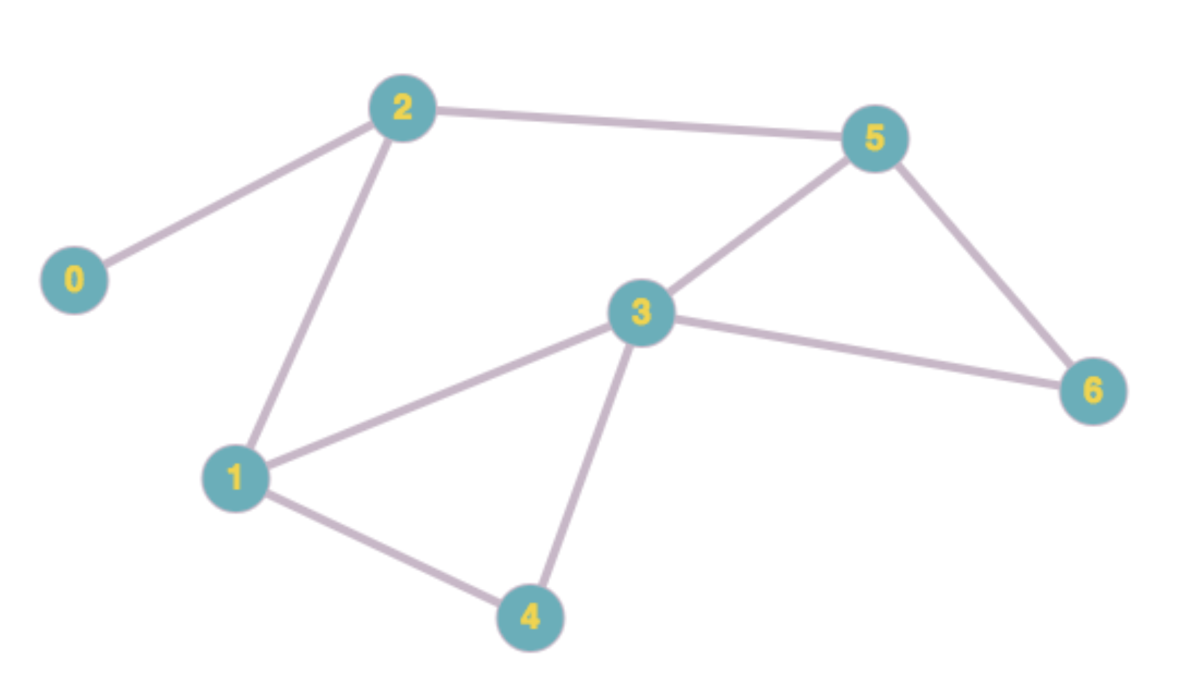
Graph
Graph is a set of nodes (vertices) optionally connected by edges (arcs)
Directed/Non Directed
Weighted/ Non Weighted
Acylclic / Cyclic
Connected / Non Connected

Slide 3
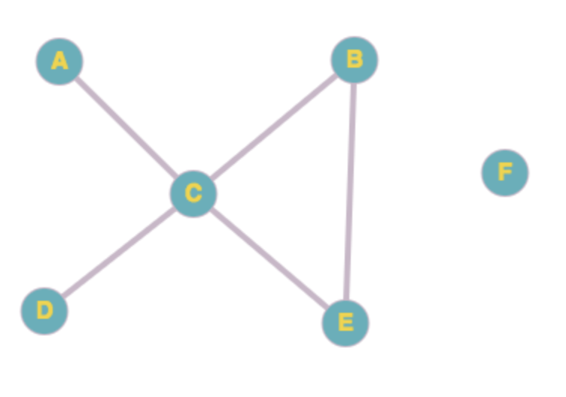
Graph Representation: Adjacency Matrix
 | A | B | C | D | E | F
A |  |  | 1
B |  |  | 1 |  | 1
C | 1 | 1 |  | 1 | 1
D |  |  | 1
E |  | 1 | 1
F

Slide 4
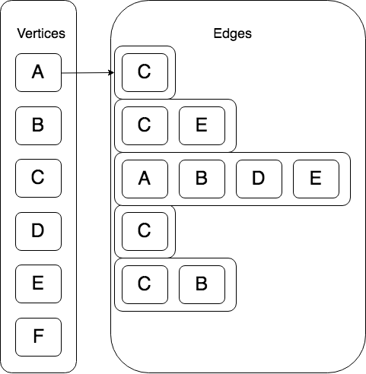
Graph Representation: Adjacency List

Slide 5
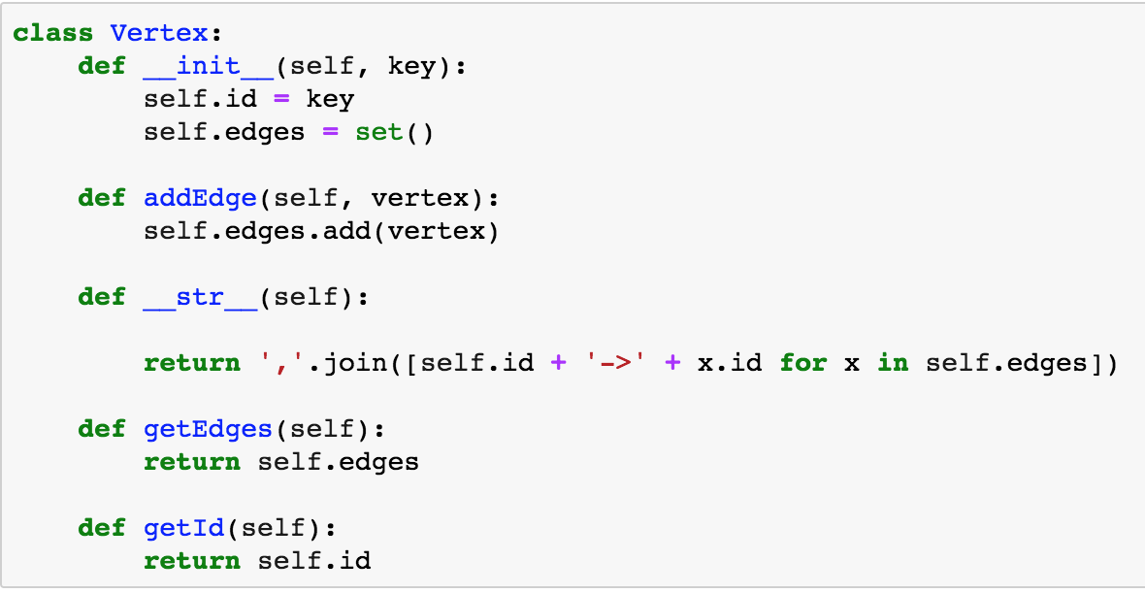
Graph Model in Python

Slide 6
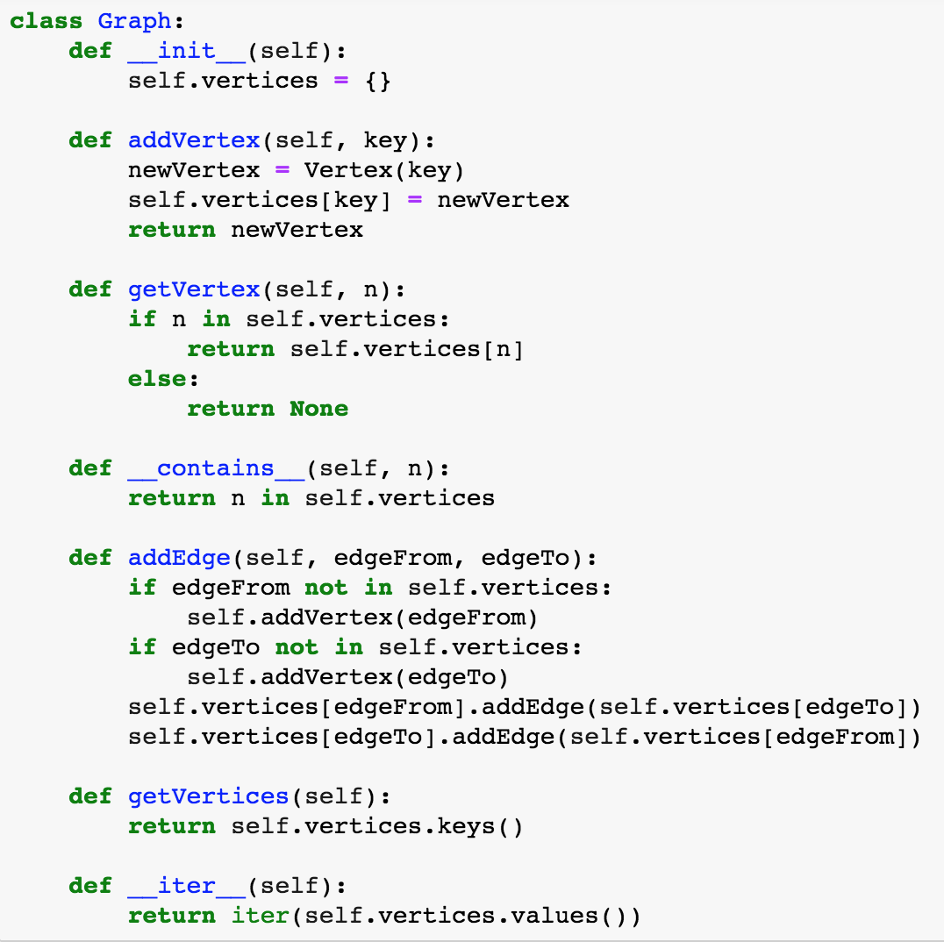
Graph Model in Python

Slide 7
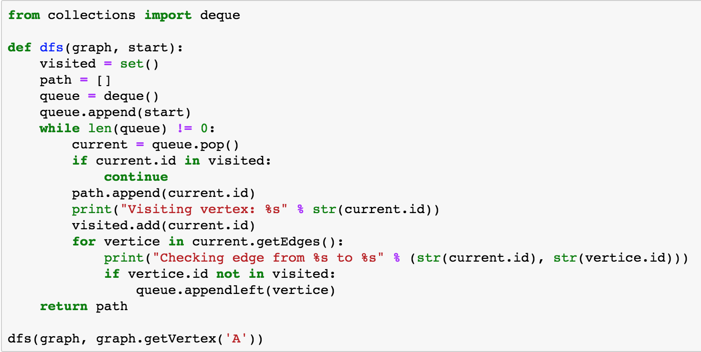
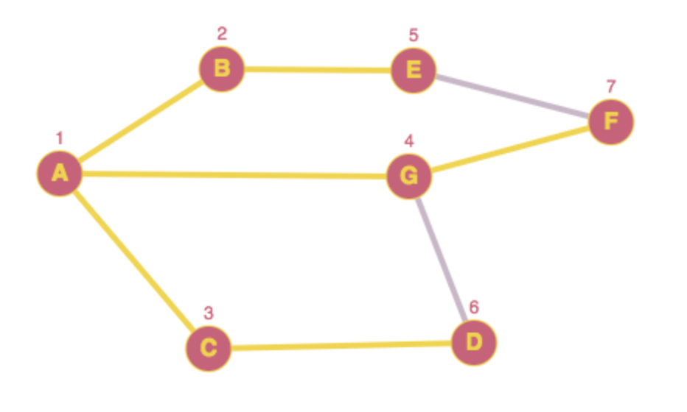
Breadth First Search

Slide 8
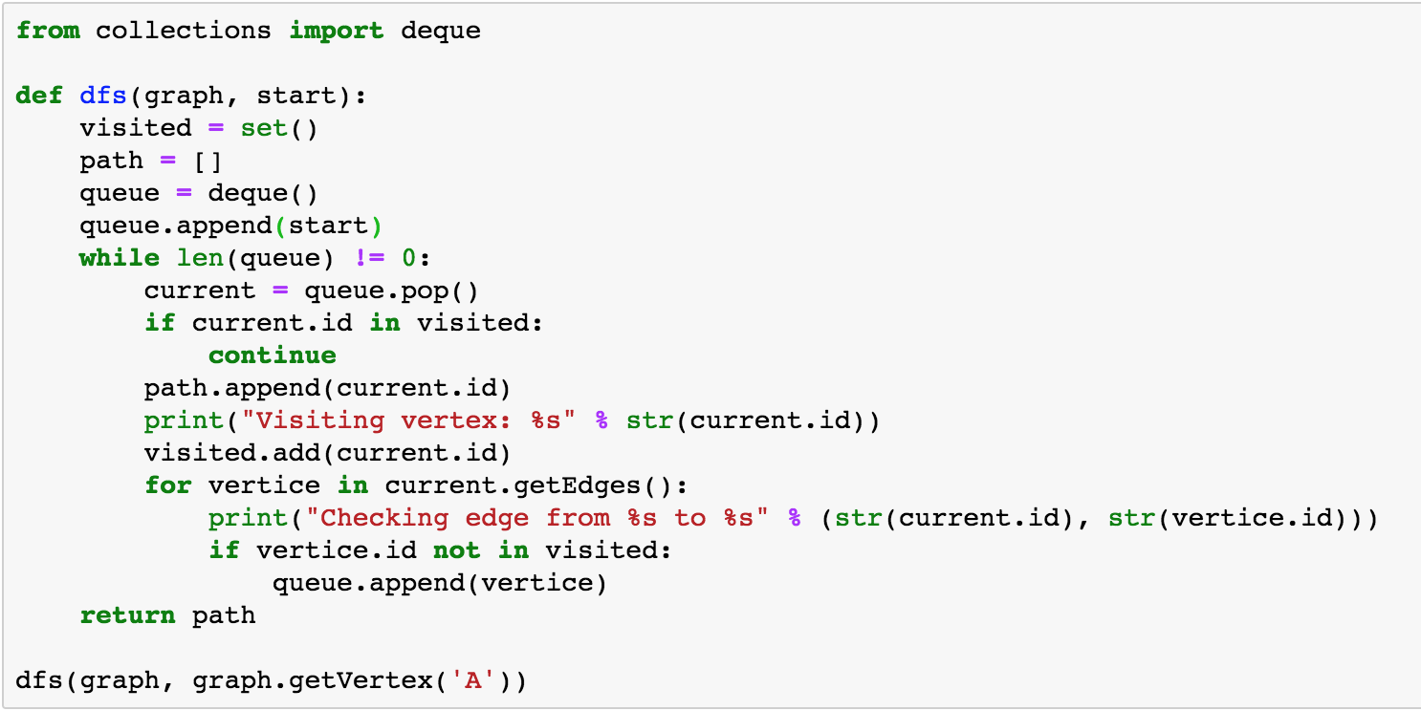
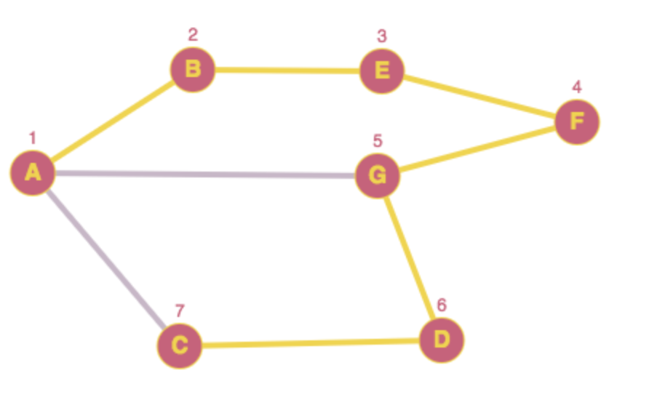
Depth First Search

Slide 9
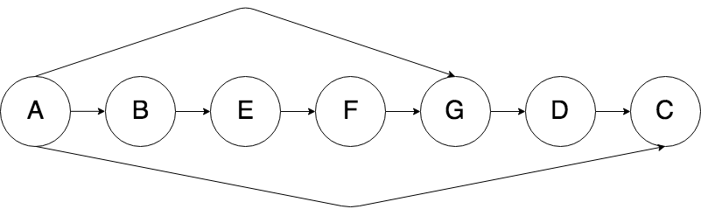
Topological Sort
Topological sort or topological ordering of a directed graph is a linear ordering of its vertices such that for every directed edge uv from vertex u to vertex v, u comes before v in the ordering

Slide 10
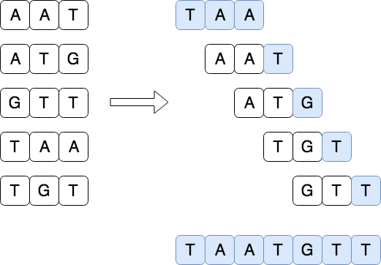
String reconstruction problem
Reconstruct a string from its k-mers

Slide 11
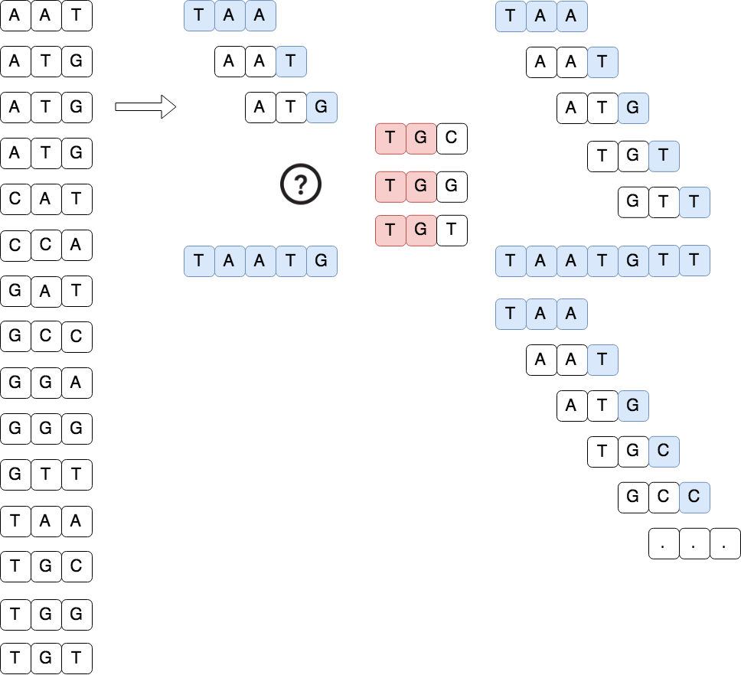
String reconstruction problem

Slide 12
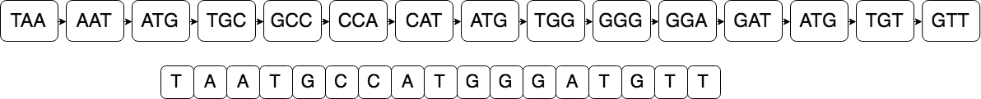
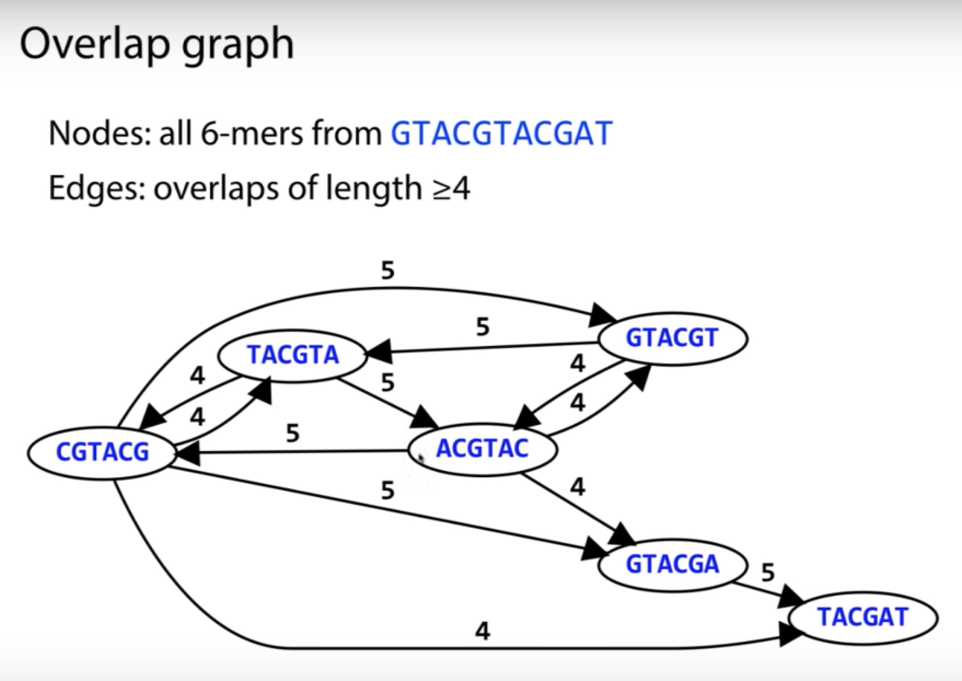
K-Mer Graph

Slide 13
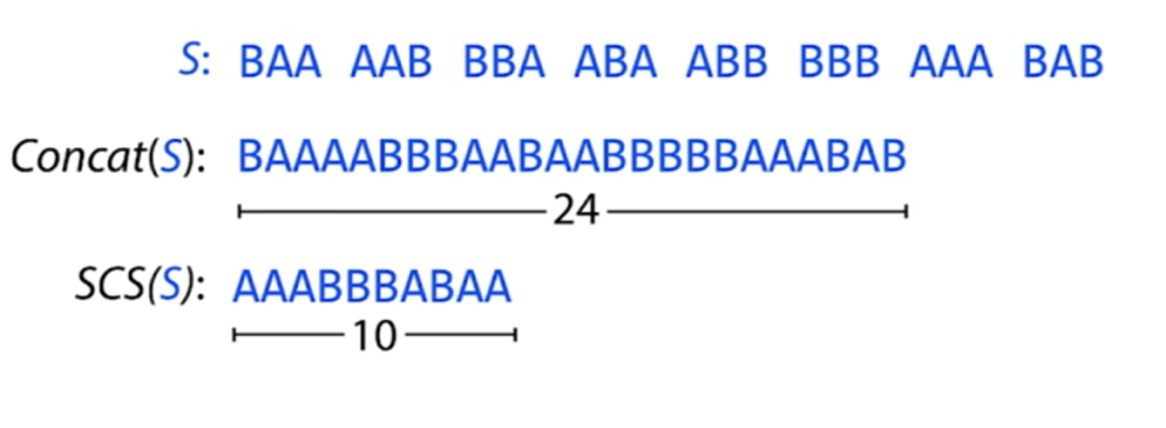
Shortest Common Superstring
Given a set of strings S find shortest string containing all strings from S as substrings.

Slide 14
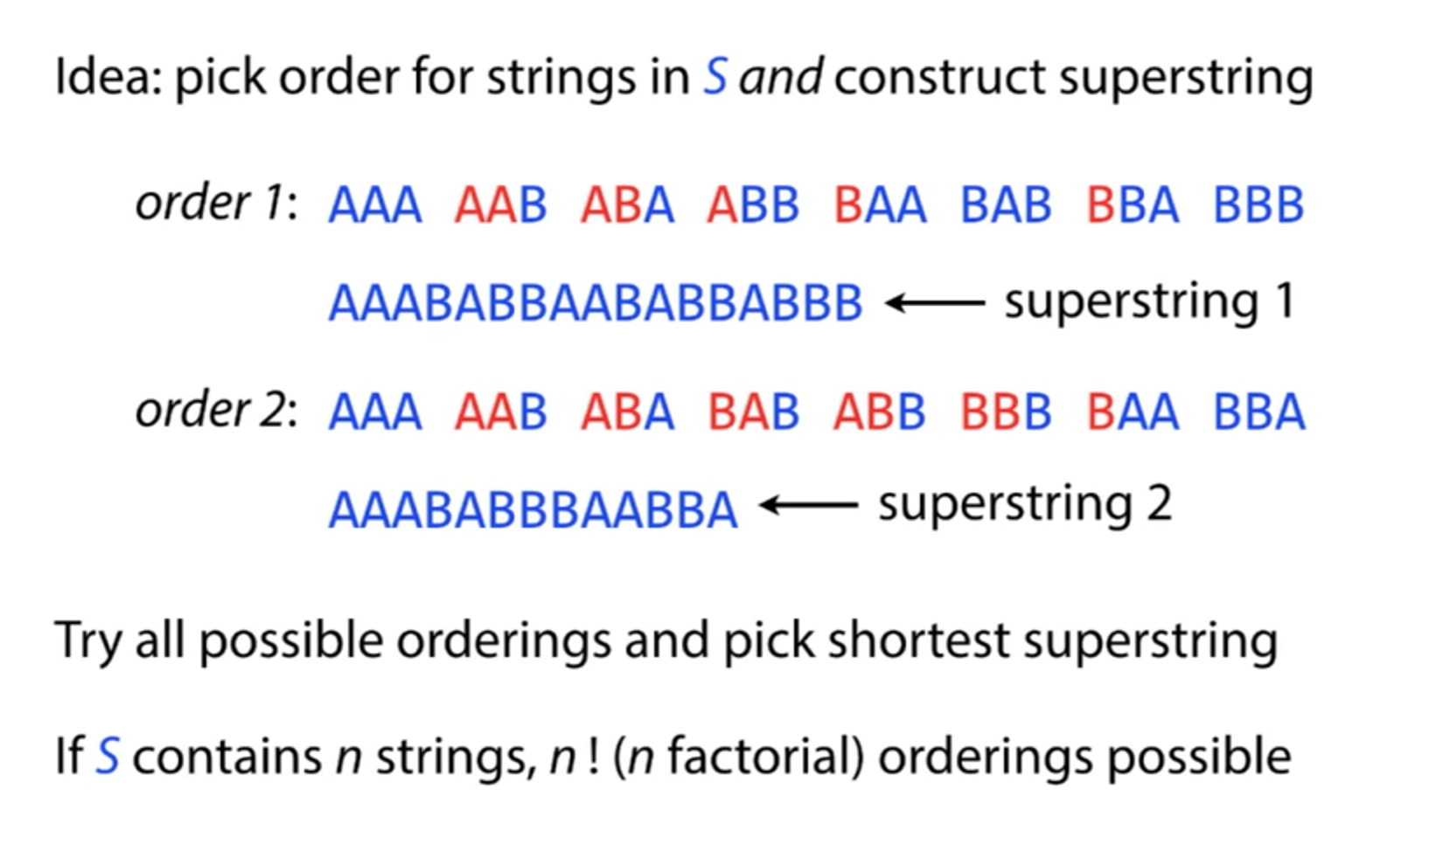
Brute Force SCS

Slide 15
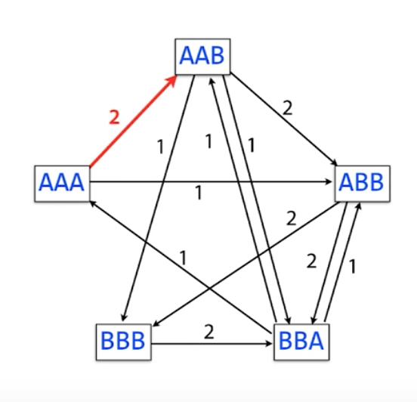
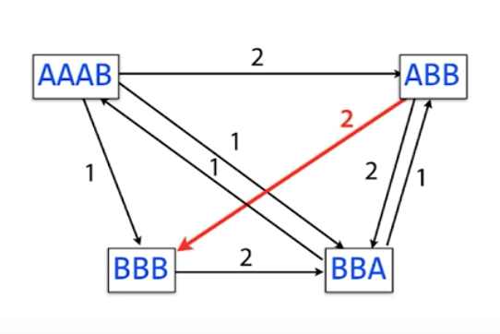
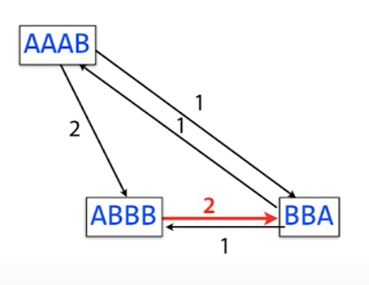
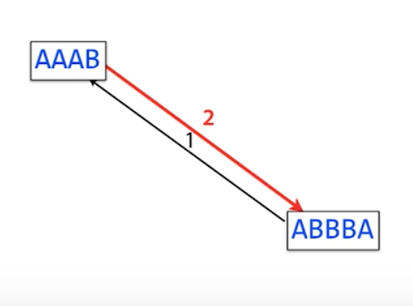
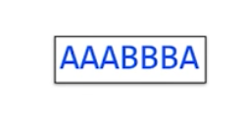
Greedy SCS

Slide 16
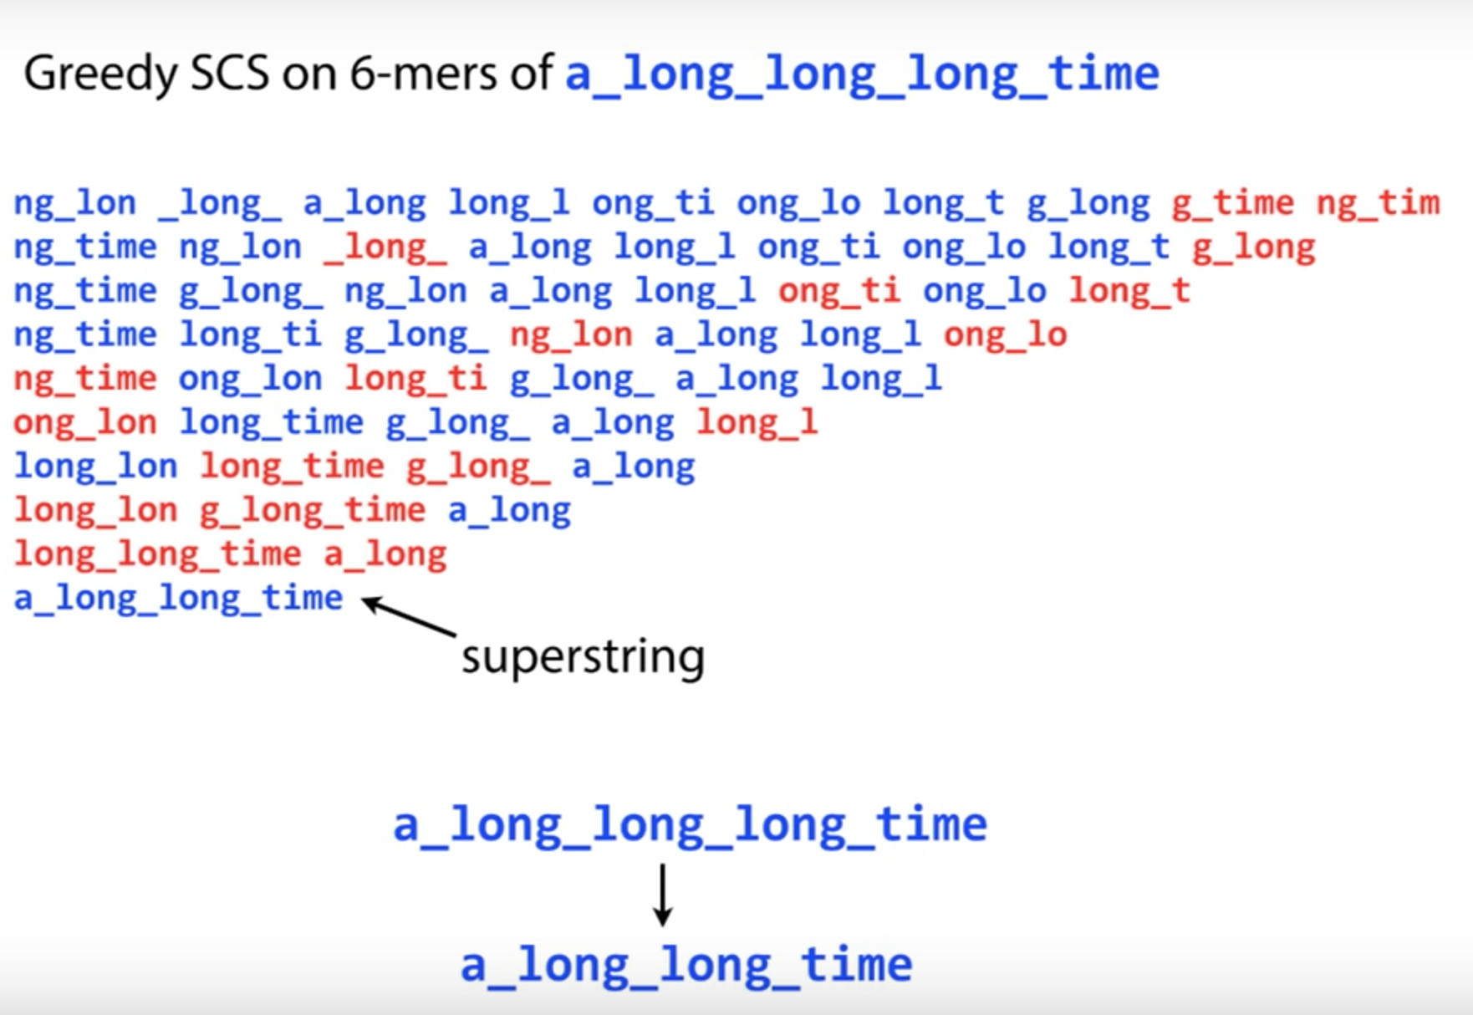
Repeats in SCS

Slide 17
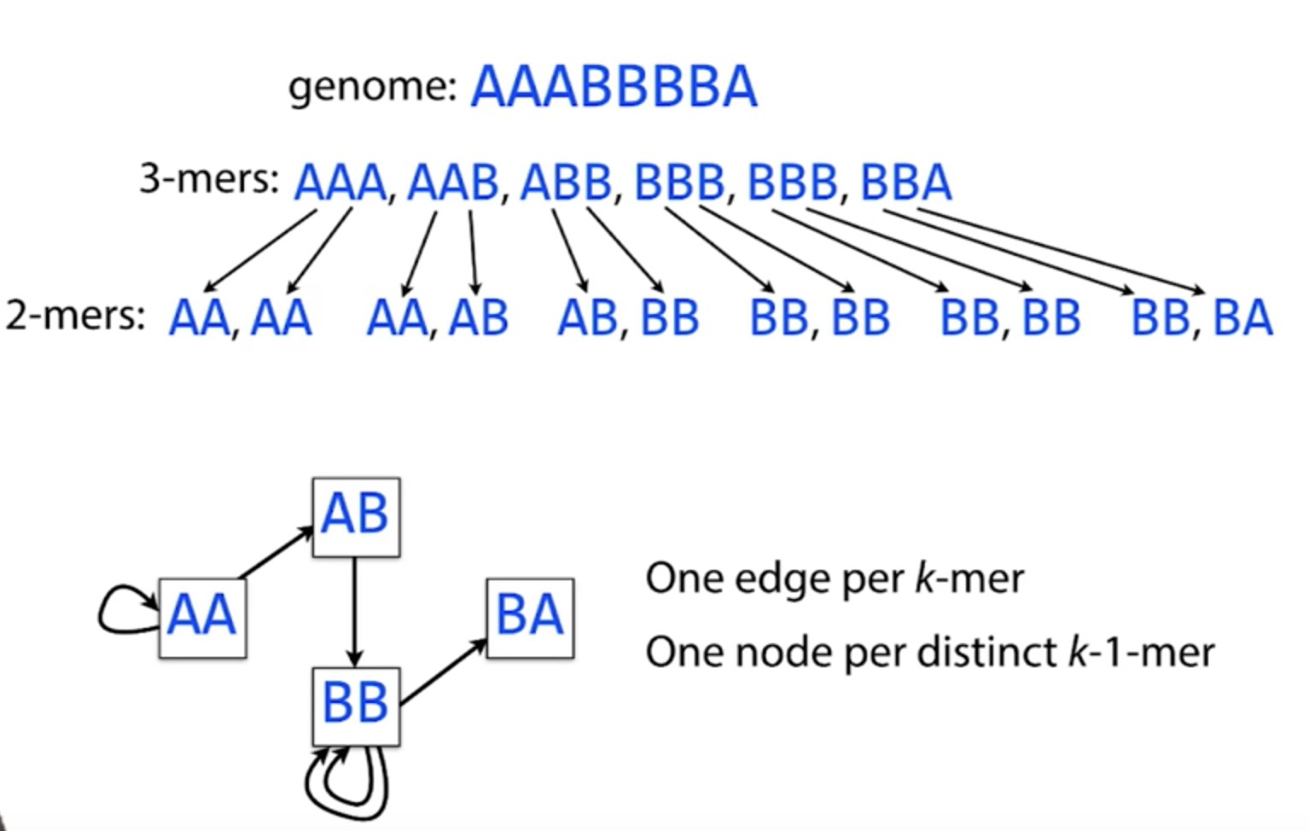
De Brujin Graph

Slide 18
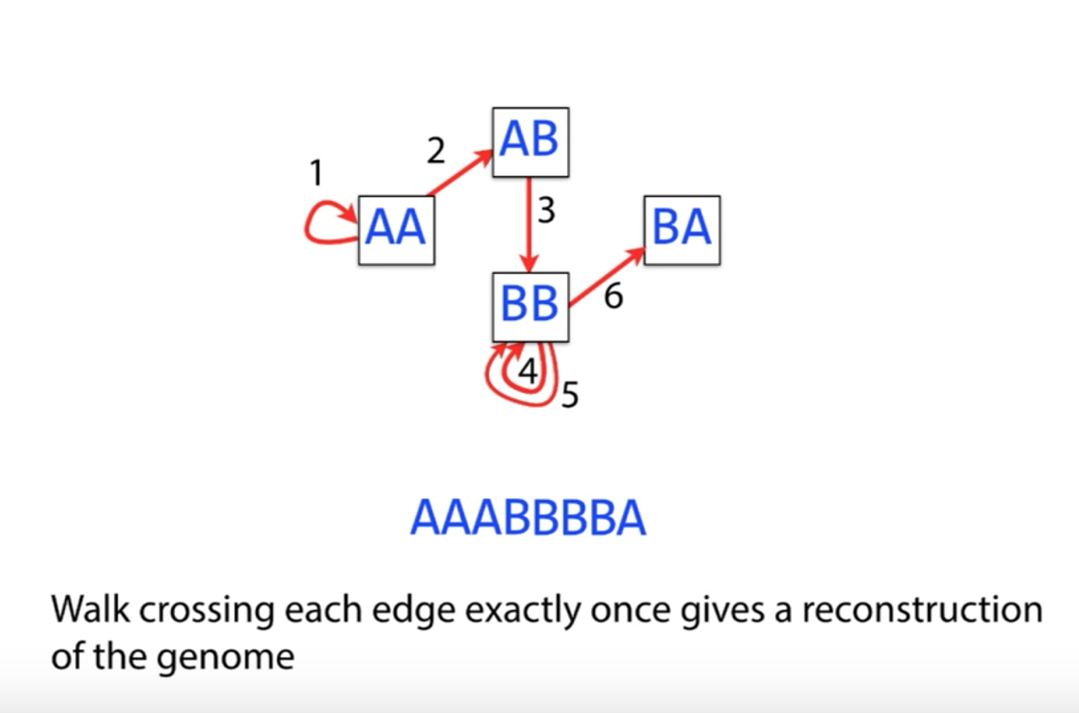
De Brujin Graph

Slide 19
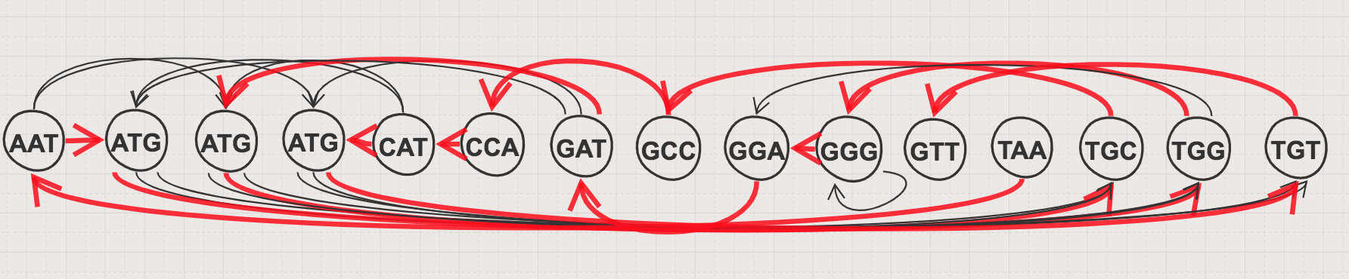
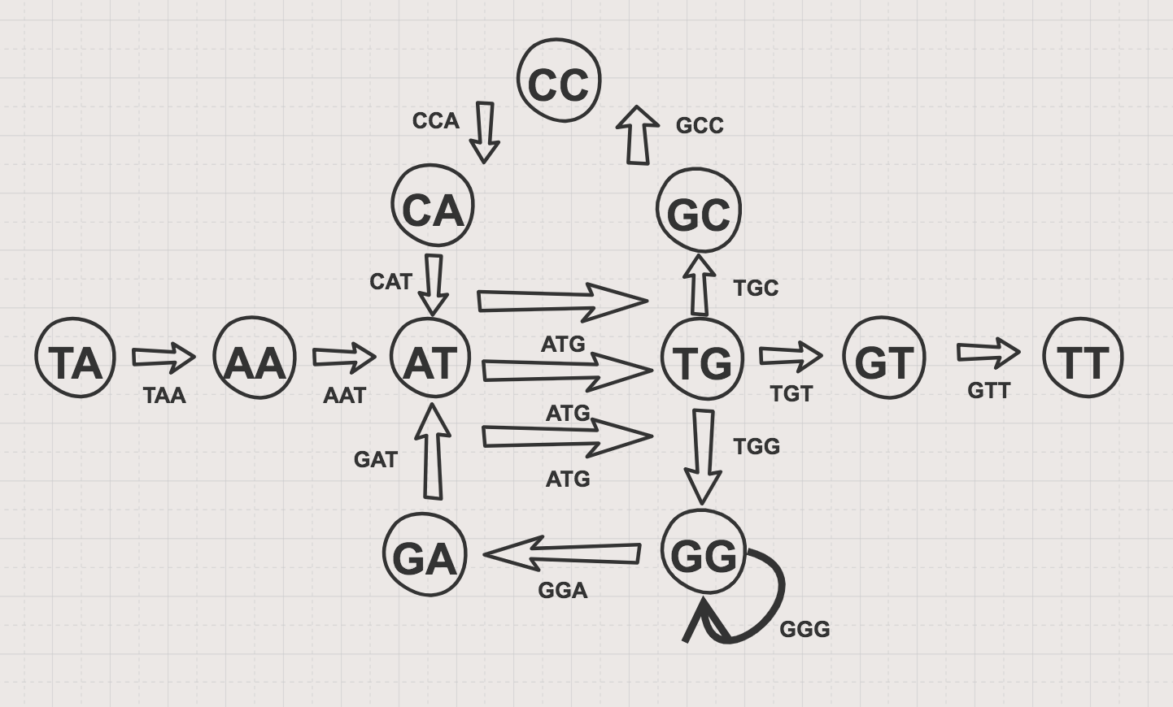
Overlap Graph vs De Brujin Graph

Slide 20
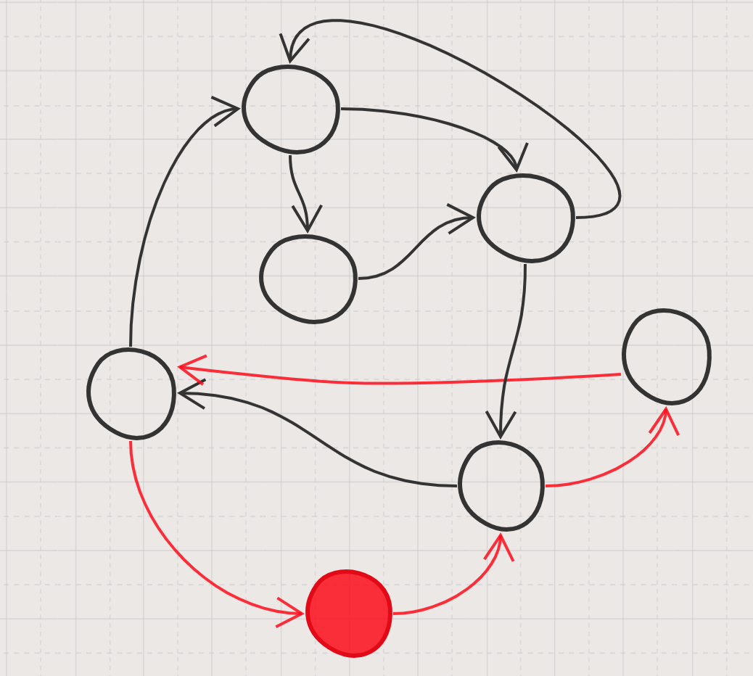
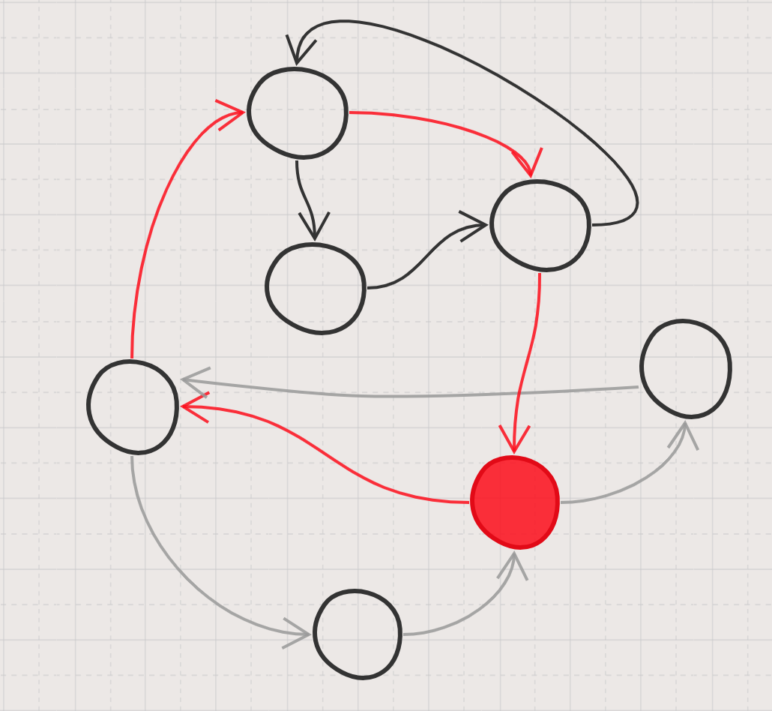
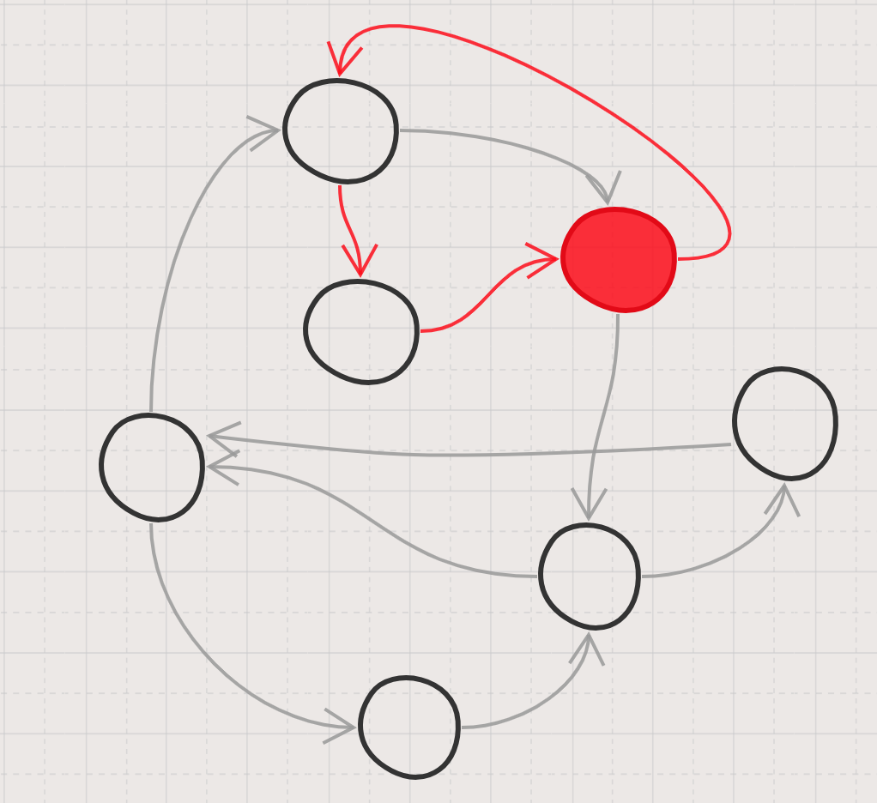
Eulerian Path

